Slide 1
THE PHYLOGENY OF PYTHIUM AND PHYTOPHTORA GENERA
Sarah Caroline de Souza
PP563 - Phylogenetic Analysis of Molecular Data

Slide 2
INTRODUCTION
Phytophthora sojae and sansomeana and several Pythium and Phytopythium species are the primary sources of root and stem rot in soybeans.
Oomycete ( = water mold) ⇨ absolutely need water.

Slide 3

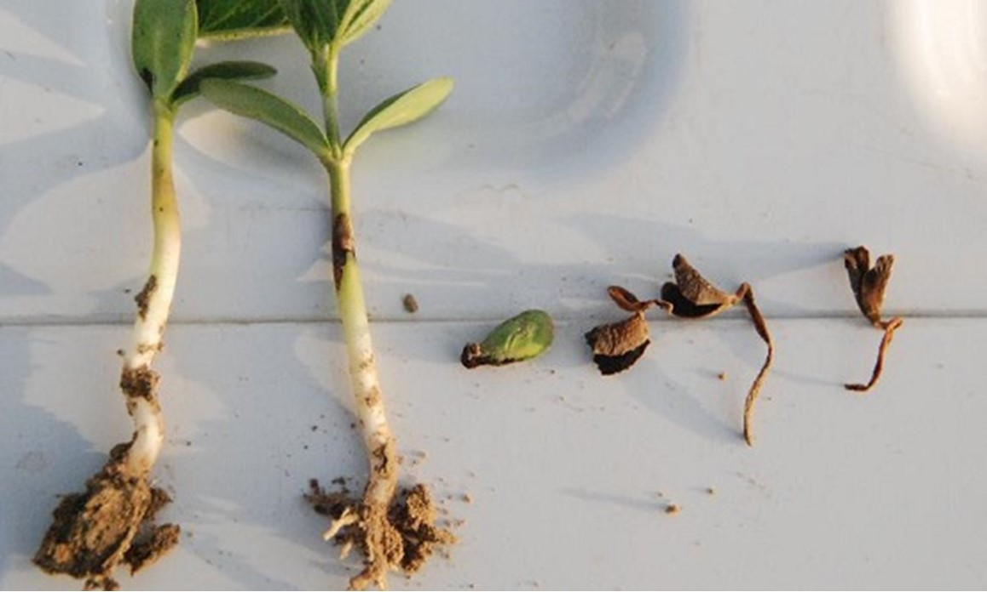
SYMPTOMS
The high similarity of symptoms caused by the different pathogens makes the identification in field impossible.

Slide 4
OBJECTIVES
OCCURENCE
GEOGRAPHICAL DISTRIBUTION
Determining the frequency of Phytophthora, Pythium, and Phytopythium.
Attributing the occurrence of these pathogens throughout the state of Wisconsin.

Slide 5
WHY TO BUILD A PHYLOGENETIC TREE?
The tree of these species can help us understand the evolutionary aspects and how it molded the behavior of these pathogens.

Slide 6
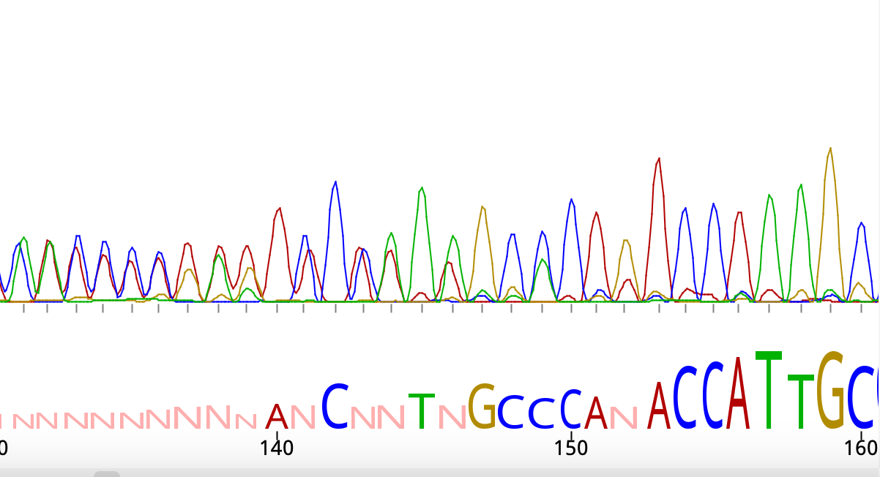
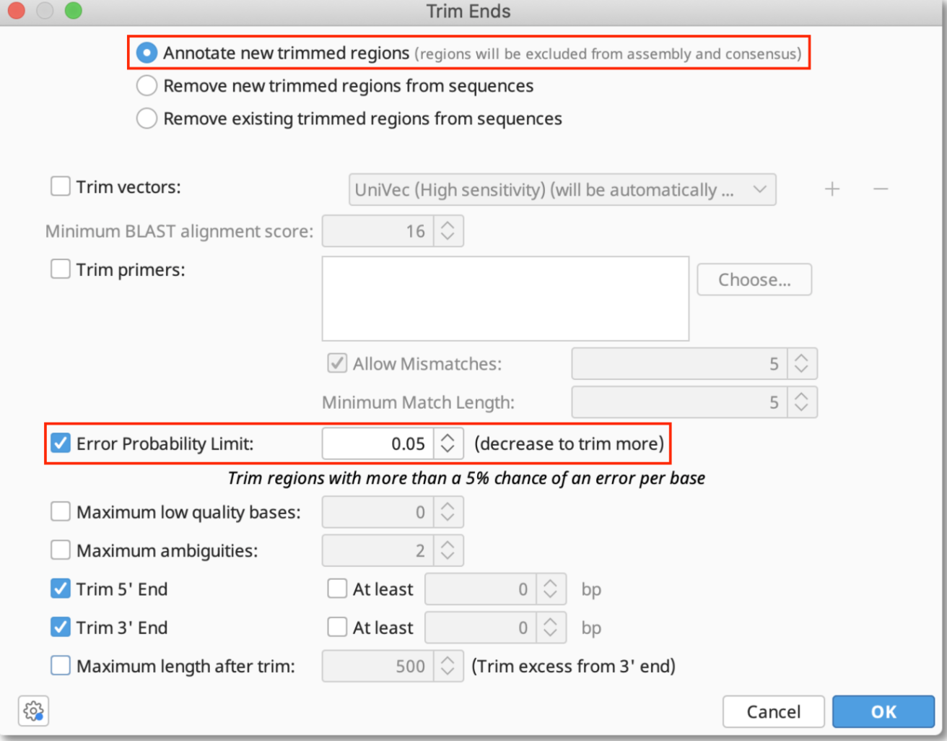
PREPARING THE SEQUENCES
Trimming poor quality edges from the SANGER sequences (ITS 6 and 4)
ITS 6 (forward) and ITS 4 (reverse) were assembled into one consensus sequence (De Novo assemble -Tadpole algorithm)

Slide 7
ALIGNING THE SEQUENCES
155 sequences
MUSCLE
Alignment
Sequences length varied from 417 to 1,011 bp.
MUltiple Sequence Comparison by Log-Expectation
The total length after the alignment was 1,399 bp.

Slide 8
02
BUILDING THE TREES

Slide 9
NEIGHBOR-JOINING TREE

Slide 10
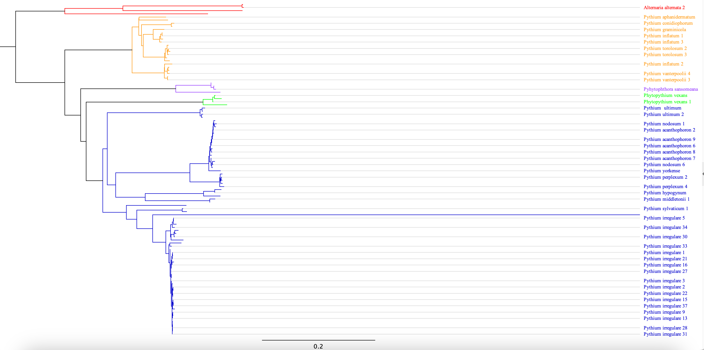
NEIGHBOR-JOINING TREE
Nodes: 211
Tips: 206

Slide 11
IQ-TREE

Slide 12
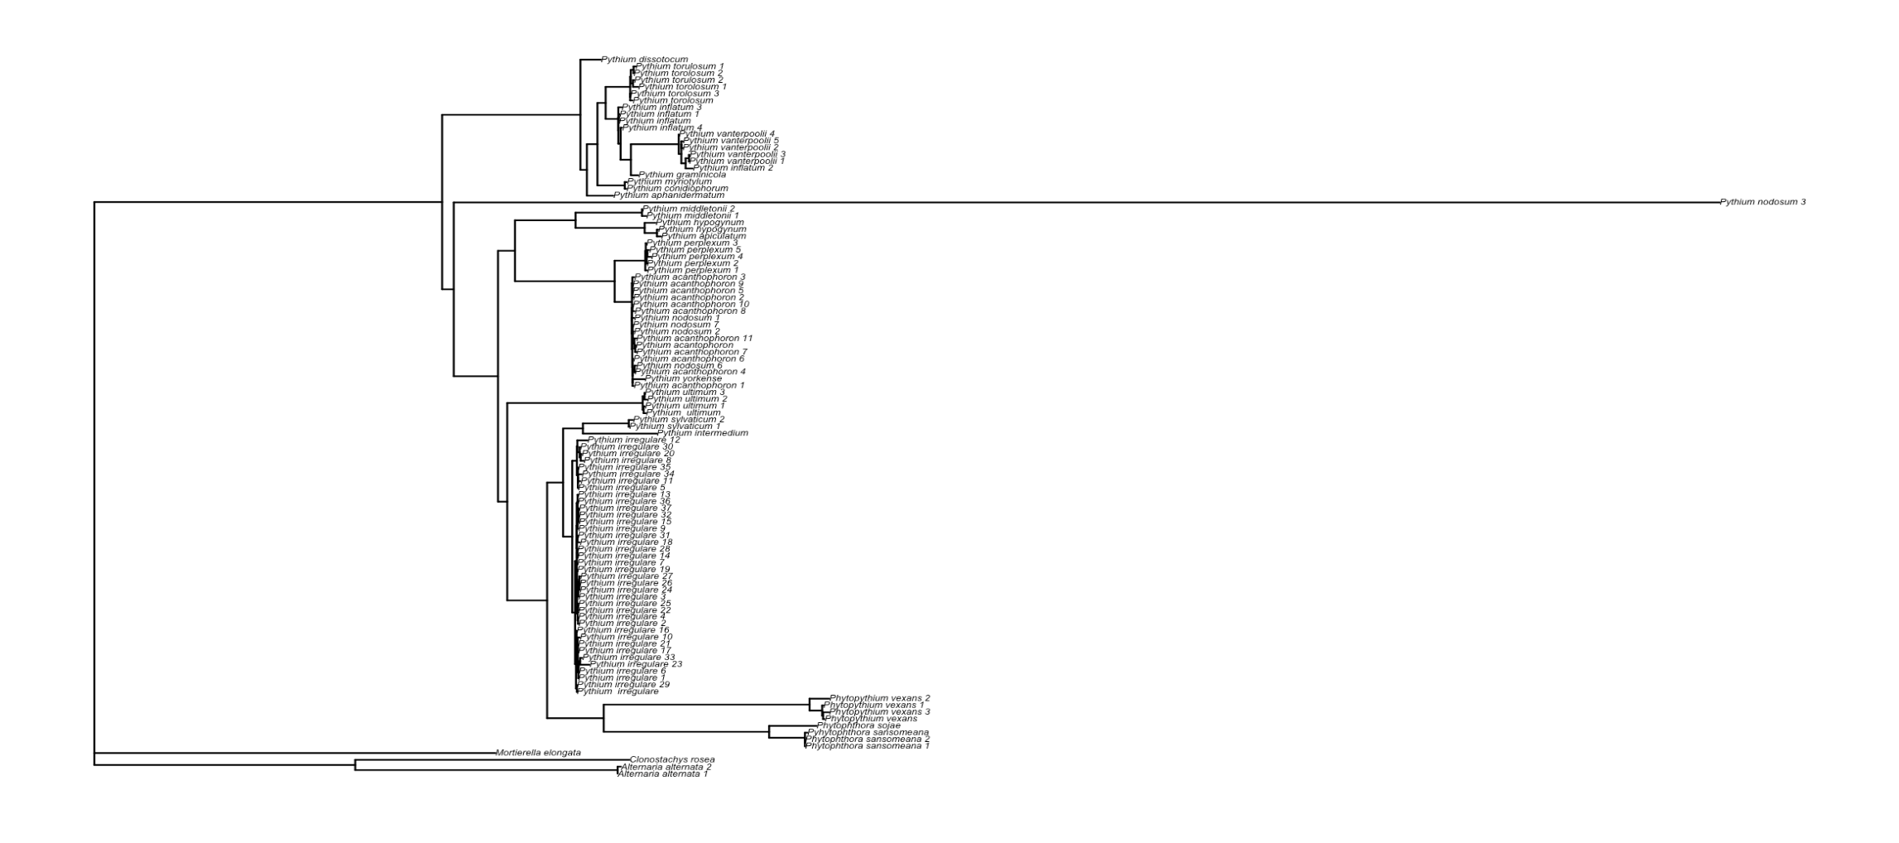
IQ-TREE

Slide 13
IQ-TREE (output)
Optimal log-likelihood: -14427.901
Base frequencies: A: 0.208 C: 0.193 G: 0.277 T: 0.322
Best score found: -14427.901
Total tree length: 11.156

Slide 14
03
CONCLUSION
You can enter a subtitle here if you need it

Slide 15
THANK YOU
Do you have any question?

